Slide 1
Population Health for COPD
Marc S. Rovner, MD, MMM, FCCP
Assistant Professor of Clinical Medicine
Directory of Pulmonary Rehabilitation
Medical Director for Population Health - COPD
Department of Pulmonary, Critical Care Medicine

Slide 2
15 20
30 40

Slide 3
New Patient

Slide 4
COPD Definitions
GOLD Criteria 2018 - Key points and Controversies
The SCOPE of the Problem of COPD at Scale
Population Health as a Solution
Our Vision for Pop Health and the unique role for Pulmonary Rehab

Slide 5
COPD Definitions

Slide 6
COPD Definitions – we can’t even agree on this!
GOLD – “Global Initiative for COP(L)D - Started by NHLBI in 1998 with revisions 2006, 2011, 2017 and 2018
All things COPD – Evidenced-based, a standard.
GOLD COPD Definition – “a common, preventable, treatable disease characterized by persistent respiratory symptoms and airflow limitation” What is airflow limitation?
Spirometry! - FVC/FEV1 ratio of <0.70
CONTROVERSY
ATS/ERS Standard (?) says airflow limitation is defined as an FEV1 below the LLN (not the ratio)
Why the difference? The ratio over diagnosis COPD in pts > age 65 and under diagnosis in pts < age 65
But there’s more…

Slide 7
GOLD Criteria

Slide 8
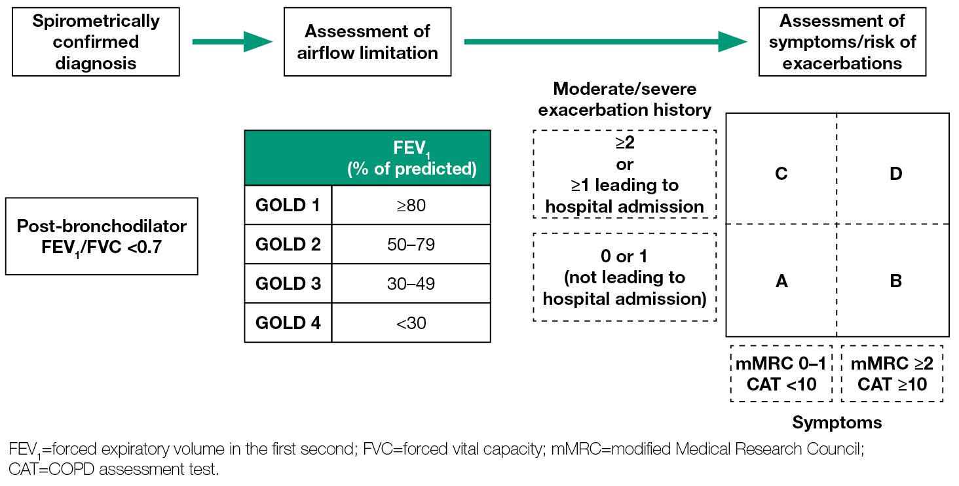
GOLD Complex Assessment of Severity

Slide 9
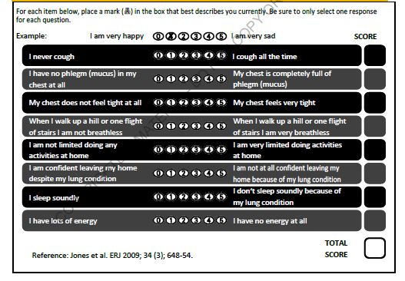
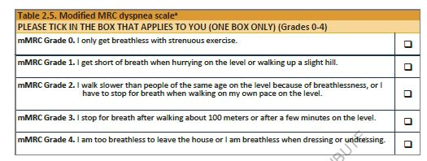
mMRC and CAT – LOOK but don’t remember!

Slide 10
Complex Assessment of Severity – Why?

Slide 11
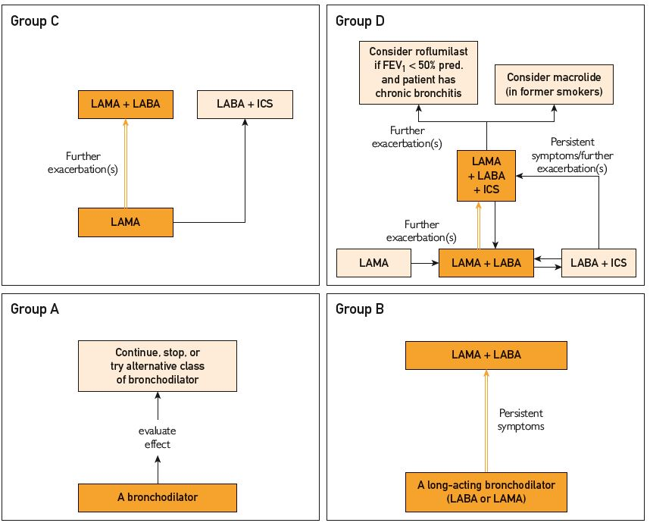

Slide 12
15 20
30 40

Slide 13
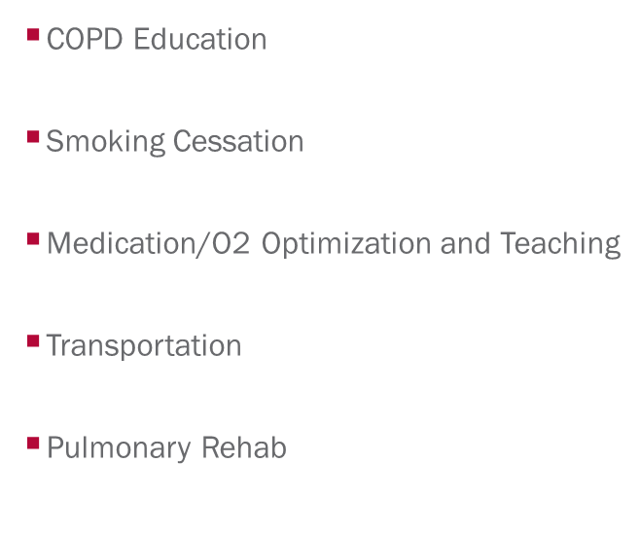
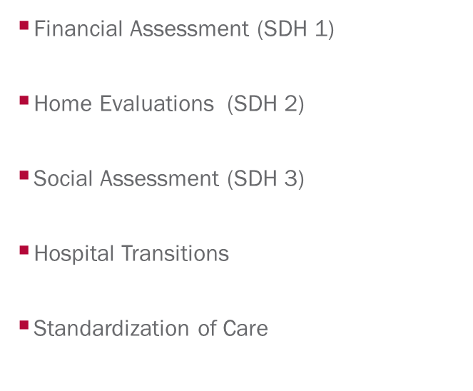
…much more to do for this patient!

Slide 14
The SCOPE of the Problem of COPD at Scale

Slide 15
SCOPE
USA
  65 million world wide, 20 million in USA
  3rd leading cause of death
  $50 billion in treatment costs per year
  Source - COPD Foundation
Indiana
  7.7% of adults have COPD
  418,000 persons
  $782 million in treatment costs

Slide 16
SCOPE - IUHP
IUHP
Risk Population
(n=27.0k)

Slide 17
SCOPE - IUHP
IUHP
Risk Population
(n=27.0k)
High
Risk
(n=830)
ER Utilization
MARA Scores
MARA - Milliman Advanced Risk Adjustment

Slide 18
SCOPE - IUHP
IUHP
Risk Population
(n=27.0k)
High
Risk
(n=830)
COPD
(3.1k)
ER Utilization
MARA Scores
Claims Dx Algorithm
Pharmacy Claims

Slide 19
Venn Diagram Prioritizes n=430 members for COPD Complex Care Management
COPD
Priority List
(n=430)
IUHP
Risk Population
(n=27.0k)
High
Risk
(n=830)
COPD
(n=3.1k)
ER Utilization
MARA Scores
Claims Dx Algorithm

Slide 20
There is still so much more to do for THESE patients!

Slide 21
15 20
30 40

Slide 22
That’s “why” Population Health!

Slide 23
Our Vision for the unique role for Pulmonary Rehab and Pop Health for COPD…

Slide 24
COPD Population Health Program Map

Slide 26
Interventions
Access to pulmonary rehabilitation
Access to smoking cessation program
Medication plan consistent with GOLD recommendations
Education of and documented competence in inhaler techniques
Influenza and pneumonia vaccinations
Transportation
Meds at discharge
COPD triage RN
Interventions for SDH (Cost, EOC, etc)

Slide 27
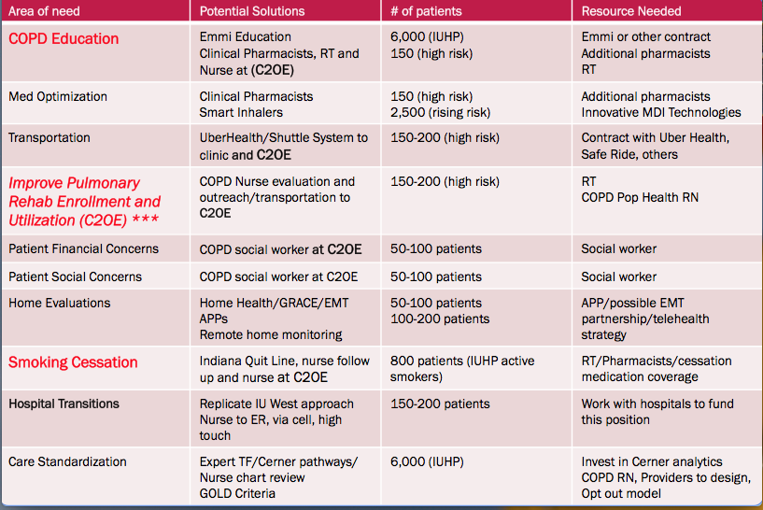
For COPD but can use same model for other ASCs

Slide 28
It starts with Pulmonary Rehabilitation.

Slide 29


Slide 30
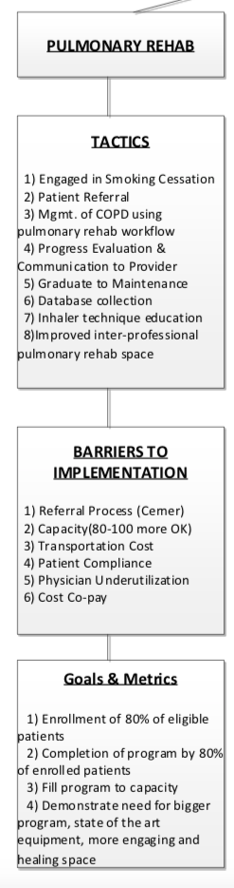

Slide 31
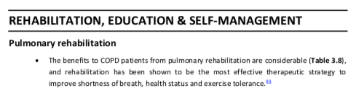
Page 18...

Slide 32
Page 18...

Slide 33
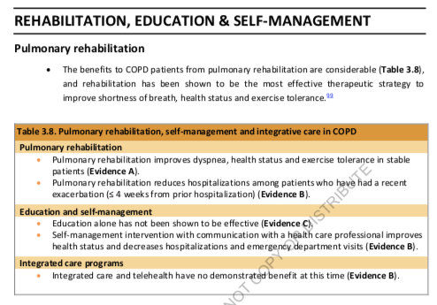
Back to page 18…

Slide 34


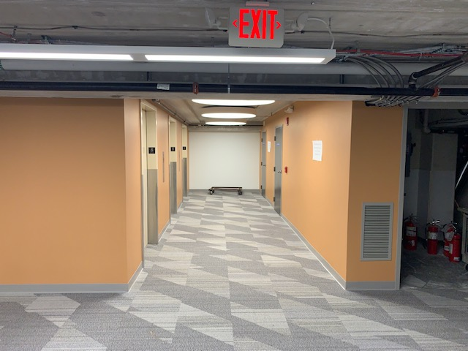
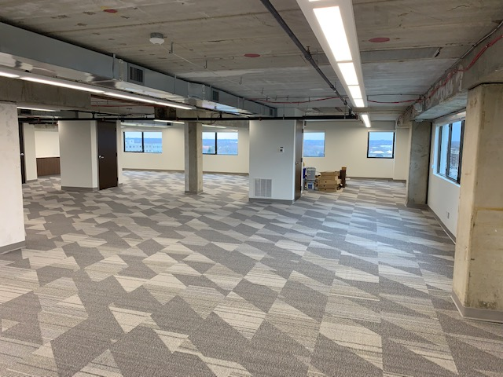
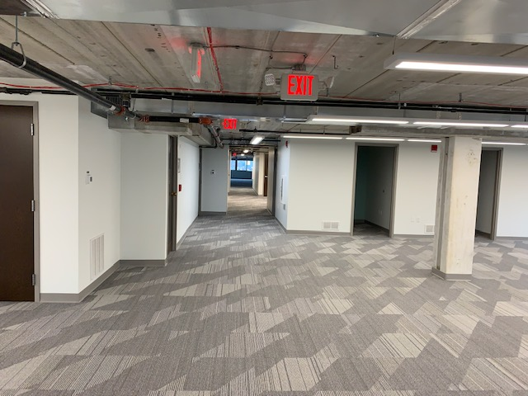


Slide 35



Slide 36
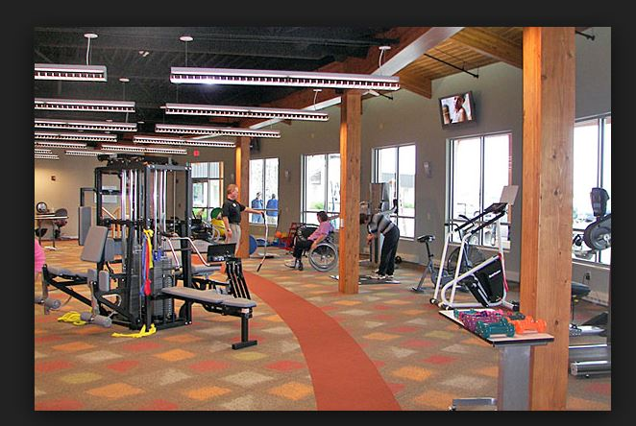


Slide 37
15 20
30 40

Slide 38


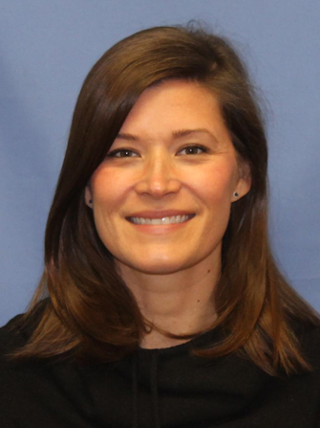

Marc Rovner, MD, Medical Director
COPD Population Health Initiative Lead Group
Richard
Bernhardt,
MD, Chair
Natalie Cline, MA
Program Manager
Anne O’Connor Clark, RN, BSN
Clinical Nursing Lead
Notes:
Talking point (Mini COPD) protocol
RRT Leaders: North – Andrea Hayes
Saxony – Jodi Newberry

Slide 39
Partners
COPD Working Group
Ellen Bardwell
Julie Barton
Rick Bernhardt, MD
Lisa Brandt
Natalie Cline
Mark Fajardo
Pat Ingle
Adria Grillo-Peck
Ed Lee
Anne O’Connor Clark
Christy O’Riley
Marc Rovner, MD
COPD Clinical Guidelines Group
Lead group from COPD Working Group
Hospitalists from IUH Methodist & West
Cerner Representatives
Executive Sponsors
Jonathan Gottlieb, MD
Greg Kiray, MD
John Fitzgerald, MD

