Slide 1
Breathing Assessment and Retraining: A Complimentary Therapy for Cardiac and Pulmonary Rehab
Julia O’Shea, RRT University of Vermont Medical Center Pulmonary Rehab Coordinator
Notes:
<number>

Slide 2
Disclosures
No relevant disclosures.
Notes:
<number>

Slide 3
DO I HAVE A PRODUCT FOR YOU!!!!
THIS IS A DEVICE YOU WILL WANT FOR YOURSELF AND YOUR PATIENTS!!!
CALL TODAY
1-888-BREATHE
Notes:
<number>

Slide 4
Objectives
Discuss the science related to breathing retraining as it relates to nasal breathing, biomechanics, biochemistry, and psychophysiology.
Discuss common presentations in Cardiac and Pulmonary Rehab where breathing education can help.
Review simple breathing practices and breathing resources.
Notes:
<number>

Slide 5
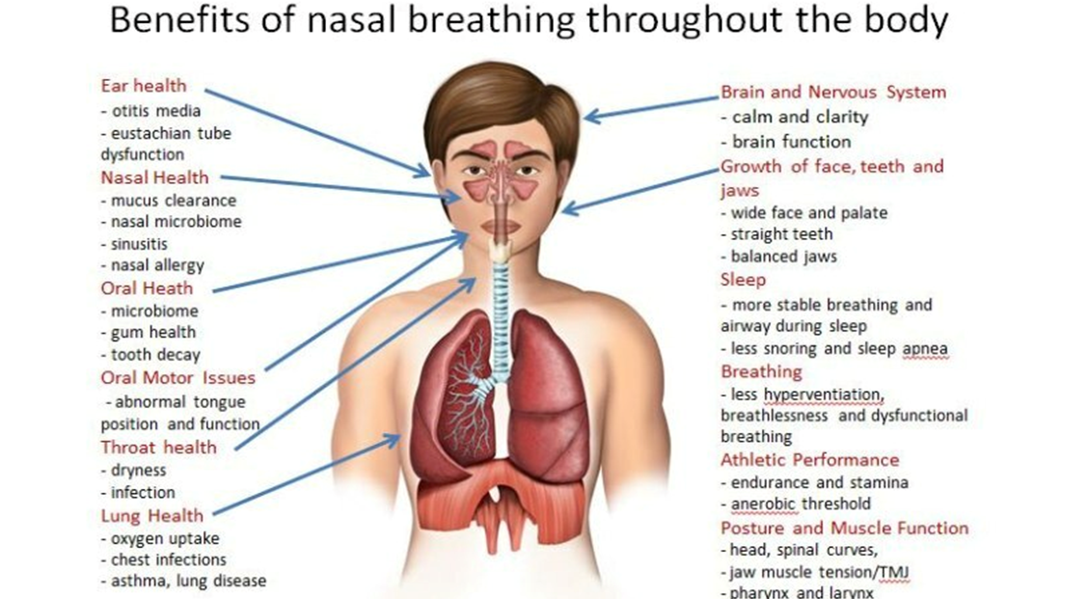
Nasal Breathing
Buteyko Breathing Method
Notes:
Warms, filters, humidifies air (less dehydration)
10-20% greater oxygen uptake than mouth breathing
Reduces stress, calms the nervous system, mental clarity
Can decrease blood pressure
Produces Nitric Oxide
Improves sleep, less snoring
Engages the diaphragm
Helps prevent catching a cold
Helps the air get deeper into the lungs…and more!
<number>

Slide 6
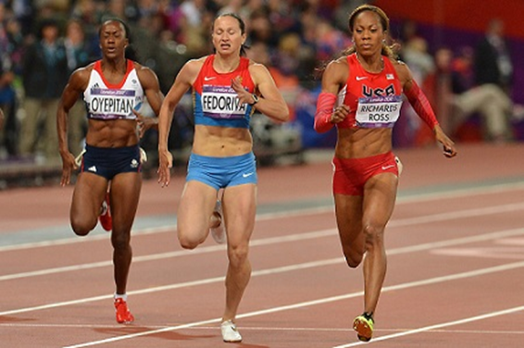
Nasal Breathing: Education
Awareness and education- filters, warms, humidifies the air
Improved performance
Patency test- use it or lose it.
Dry mouth- daytime or upon waking up
Cottle maneuver- use of nasal dilators or breathe strips
Consider referral to ENT with obstruction
Sanya Richards-Ross, Olympic Gold Medalist-photo Roger Sedres
Notes:
<number>

Slide 7
Nasal Breathing: Breathing Zones and Exertion
ZONE | BREATH TYPE
1 | NOSE-NOSE
2 | INCREASE RR NOSE-NOSE
3 | NOSE-MOUTH (PURSED LIP)
4 | MOUTH-MOUTH
5 | MOUTH-MOUTH ERRATIC-RAPID
RPE
2-3/10
4-5/10
6-7/10
8-9/10
9-10/10
Notes:
<number>

Slide 8
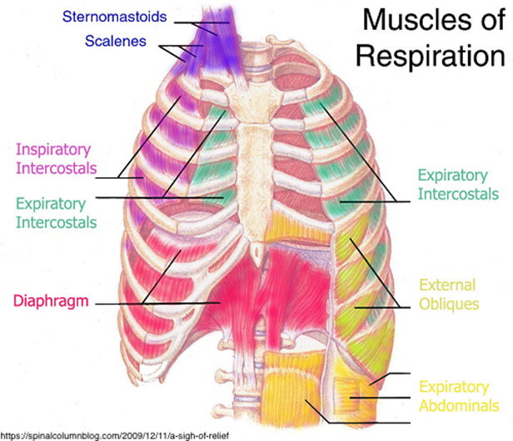
Biomechanics of Breathing
Diaphragm
Accessory muscles
Skeleton: ribcage, spine
3 diaphragms; vocal cords, diaphragm, pelvic floor
Breathing and postural stabilization (includes balance)
Notes:
<number>

Slide 9
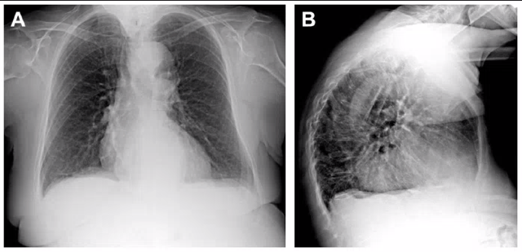
Biomechanics: Breathing Pattern Presentations
Upper chest breathing vs abdomen- dead space ventilation
Deconditioning
Lack of neurological connections- neuromuscular disease
Diaphragm paralysis
Abdominal or pelvic conditions
Obesity, OSA, and other comorbidities.
Rigidity of the ribcage and thoracic spine- COPD, hyperinflation, cardio-thoracic surgeries
Notes:
<number>

Slide 10
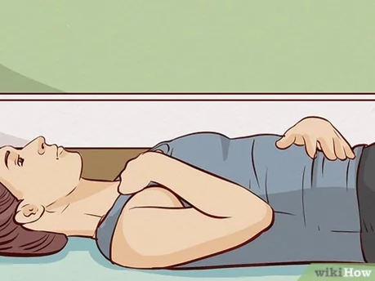
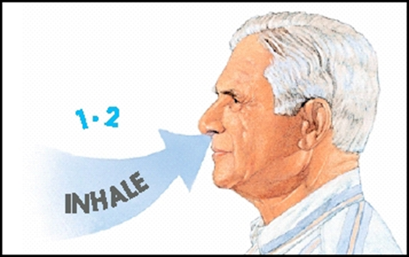
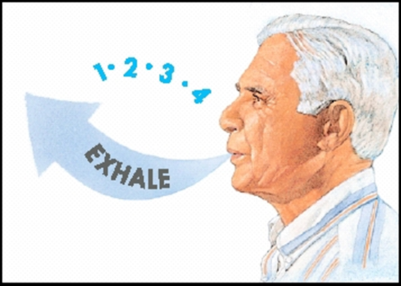
Biomechanics: Education
Hi Lo test- hand on upper chest, hand on abdomen (Awareness is step one!)
Diaphragmatic Breathing- supine, seated, standing, with resistance
Pursed lip breathing
Postural awareness- mobility
Exhale on exertion, ex. Stairs
Recovery positions, down regulate
Paced breathing- breathing zones
“Nose, low, slow” Buteyko Method
“When in doubt, exhale out” BradCliff Method
Notes:
<number>

Slide 11
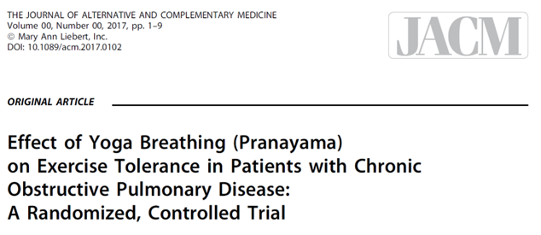
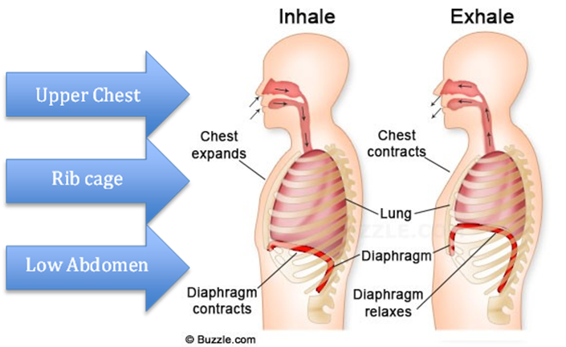
Biomechanics: Education
Dr. David Kaminsky pilot study
3 Part breath
6MWD increased
Small improvements in inspiratory capacity and dynamic air trapping.
Improved measures of dyspnea and quality of life.
Notes:
<number>

Slide 12
Biomechanics: Respiratory Muscle Training
Exercise- Cardiac and Pulmonary Rehab
Inspiratory muscle training- trains diaphragm and accessory muscles.
Expiratory muscle training- trains internal intercostals, rectus abdominis, external and internal obliques and transversus abdominis.
Passive flow resistance- breathing trainers that use flow resistive loading usually consist of holes of varying sizes.
Threshold resistance- spring-loaded valve that will only open once you are able to generate enough inspiratory pressure.
Notes:
<number>

Slide 13
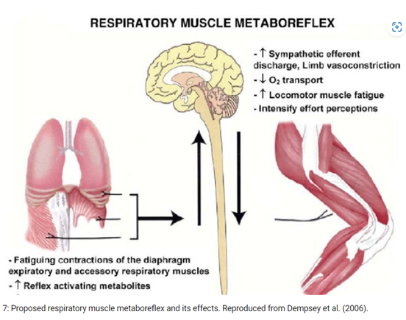
Biomechanics: Respiratory Muscle Metaboreflex
Increased work of breathing with increased blood flow demand to diaphragm
Blood “stealing” from locomotor limbs
Sympathetic nervous system vasoconstrictor neurons
Goal is protection of O2 delivery to the respiratory muscles
Notes:
<number>

Slide 14
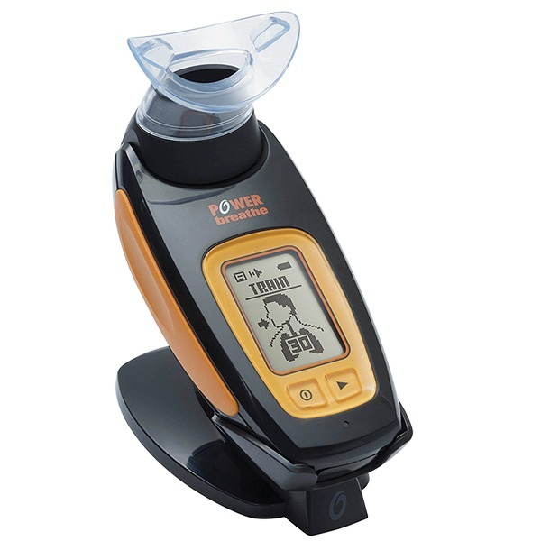
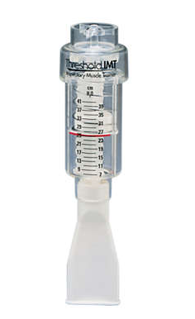
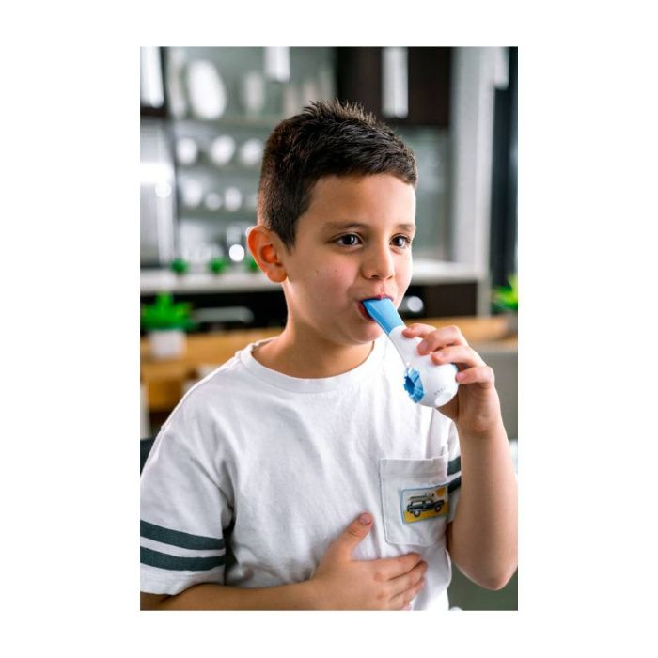
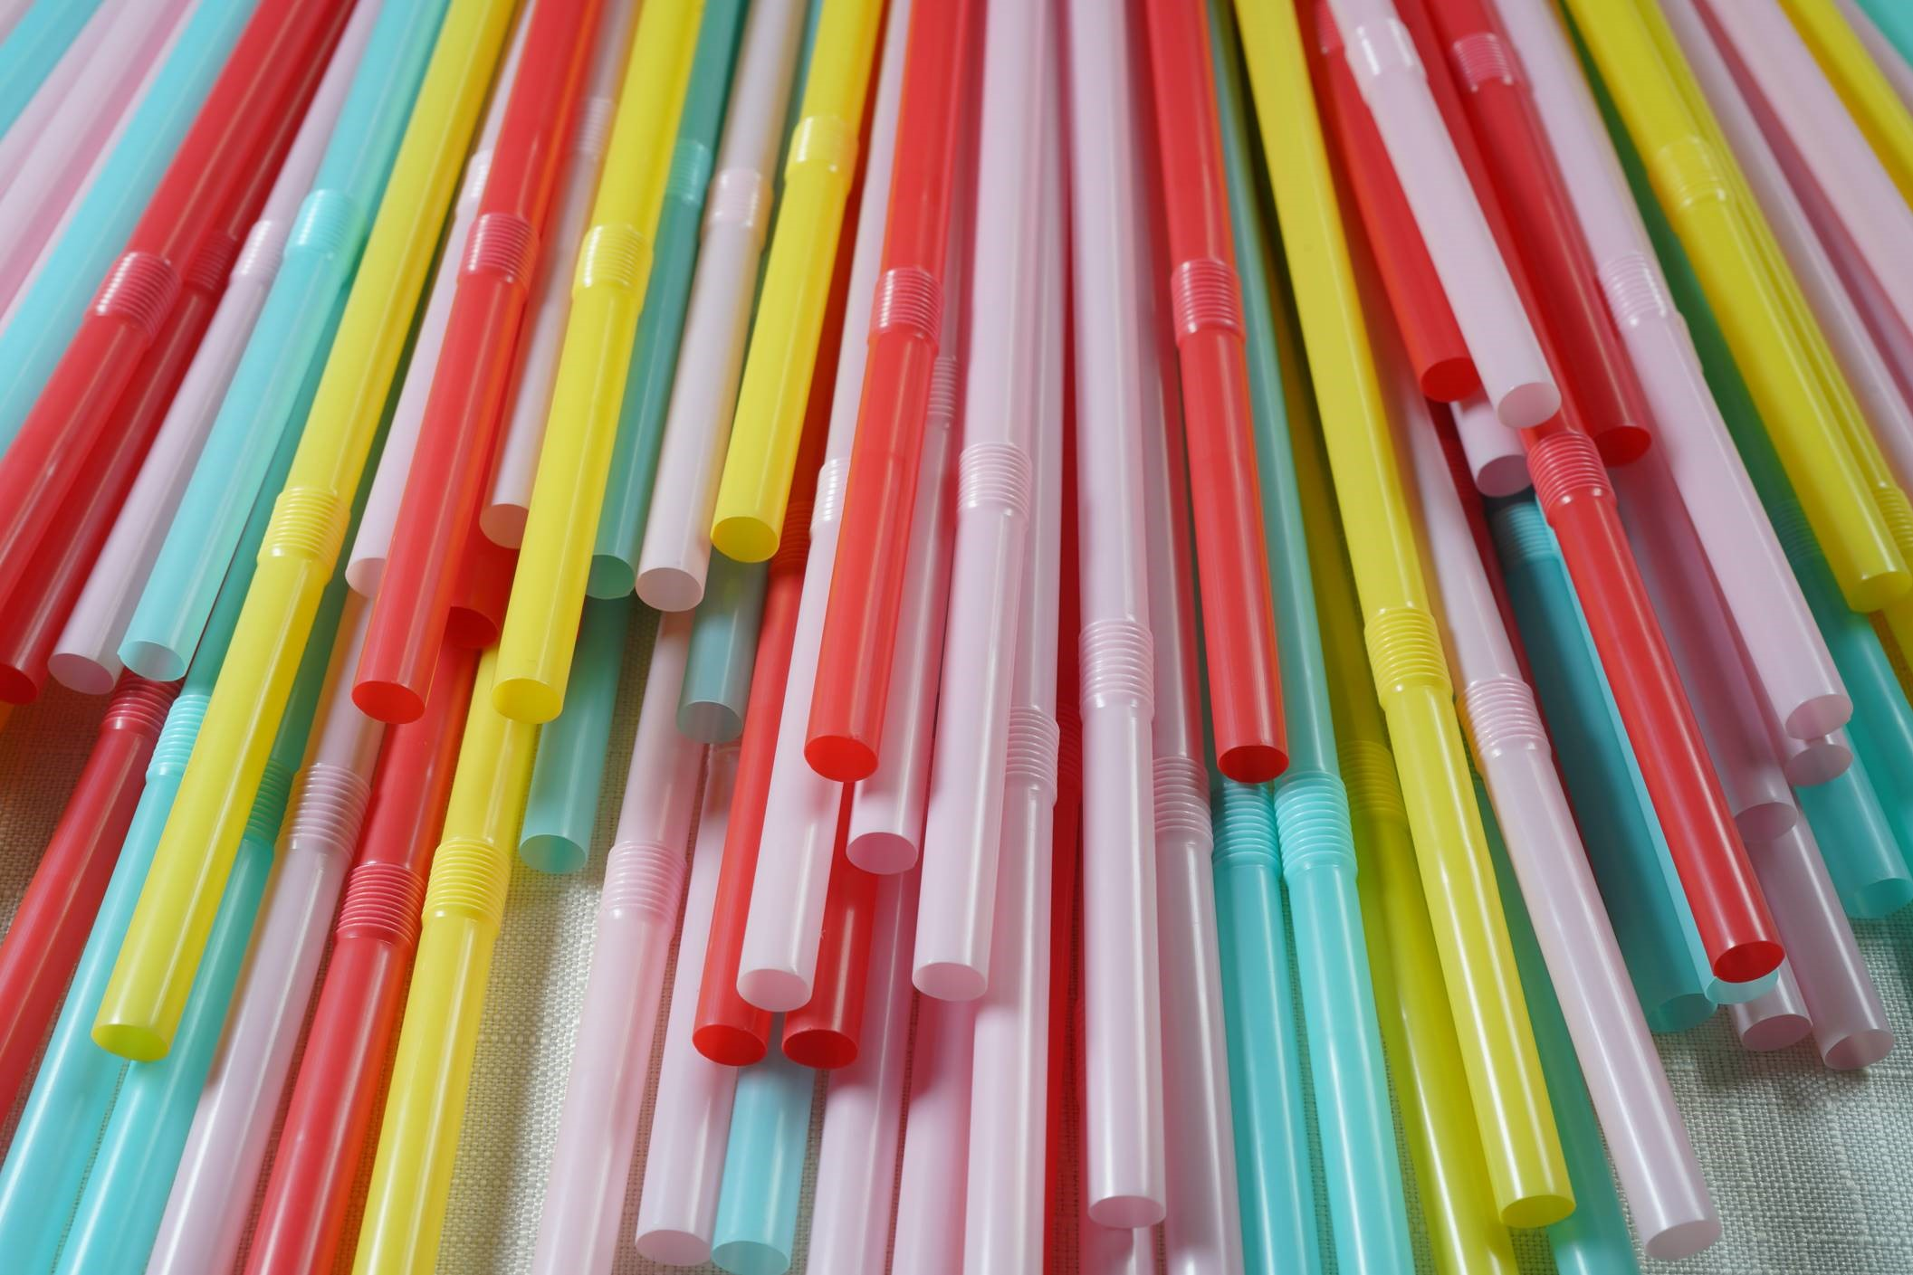
Biomechanics: Inspiratory Muscle Training
When to use?
Respiratory muscle weakness
post-ICU
diaphragm paralysis
long COVID
HTN
Limitations- cost and time to educate
Proper education and dose- which muscles are you training?
Notes:
<number>

Slide 15
Biomechanics: Inspiratory Muscle Training COPD
IMT may not improve dyspnea, functional exercise capacity and life quality when associated with PR.
However, IMT is likely to improve these outcomes when provided alone.
Considerations:
Stand-alone therapy or part of a PR program
Initiate before PR for those waiting to start or those with severe deconditioning
Include in home exercise routines alongside PR
Notes:
Considerations for IMT in COPD
Patient Prioritization:
PR participants with weak inspiratory muscles- Maximum Inspiratory Pressure (MIP) < 70% predicted
Patients with dyspnea as their main limiting factor
Motivated individuals aiming to maximize rehab benefits
Protocol Guidelines:
No definitive best program; common protocols use 30%-50% of MIP
Typical dosage: 30 breaths, twice daily, for 5-10 minutes
Encourage full tidal volume and vital capacity inspirations with strong, deep breaths
Breathing Mechanics & Education:
Assess the need for rib cage and thoracic spine mobility work
Teach breathing pattern awareness (diaphragmatic breathing, lateral rib movement, upper chest control)
Consider bronchodilators and pursed-lip breathing to support exhalation between training breaths
Integration Into Rehab:
Can be a stand-alone therapy or part of a PR program
Initiate before PR for those waiting to start or those with severe deconditioning
Include in home exercise routines alongside PR
Outcome Measures:
Assess dyspnea pre/post and during exercise
Regular inspiratory muscle testing to track progress
define
<number>

Slide 16
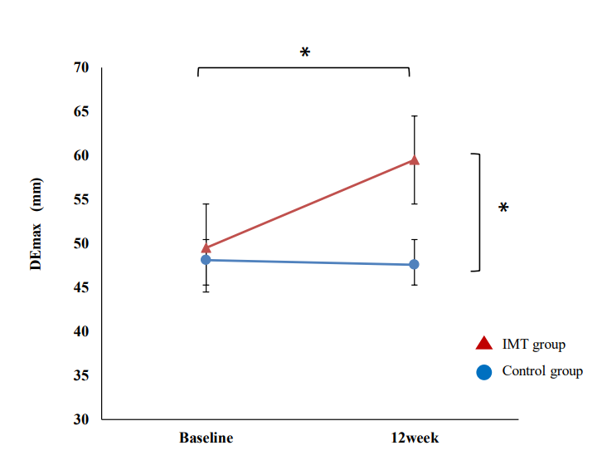
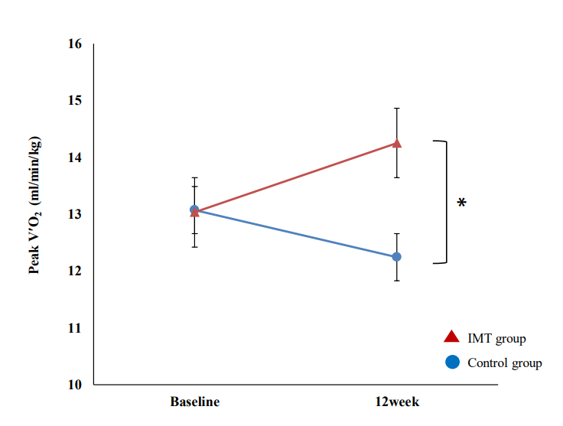
Biomechanics: Inspiratory Muscle Training COPD
Enhanced diaphragm excursion and exercise
tolerance in COPD patients through inspiratory muscle training after standardized pulmonary rehabilitation: randomized controlled trial
Shiraishi M, Higashimoto Y, Sugiya R, et al. ERJ Open Res 2024
Notes:
<number>

Slide 17
Biomechanics: Inspiratory Muscle Training Long COVID
Single –center blinded, RCT 26 patients with previous admission.
The IMT arm improved their peakVO2 significantly compared with usual care (+Δ 4.46mL/kg/min, 95%CI 3.10 to 5.81; p<0.001).
Similar positive findings were found when evaluating changes for CIx and some QoL dimensions.
Did not find significant changes in ventilatory efficiency.
The pathophysiology of Long-COVID is complex and multifactorial with often long lasting symptoms.
Most common symptoms of Long-COVID- muscle weakness, fatigue, and breathlessness.
Notes:
<number>

Slide 18
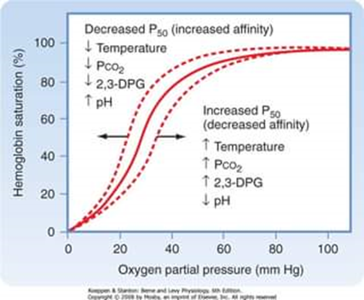
Biochemistry of Breathing
Role of carbon dioxide and oxygen
CO2 primary driver to breathe
Bohr effect- relationship between CO2 and hemoglobin, we need a certain amount of CO2 to assist with the delivery of O2 into the cells and tissues.
Notes:
<number>

Slide 19
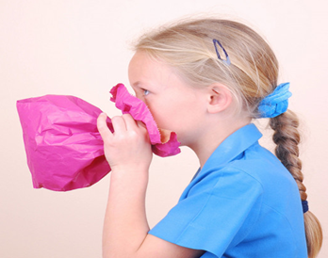
Biochemistry: Breathing Pattern Presentations
Hyperventilation- breathing in excess of metabolic demands (acute and chronic) Treat the cause before becoming chronic. Low CO2
Periodic deep sigh or erratic pattern of sighs and yawning
Breath holding or apnea
Low breath hold times on Inhale and Exhale
Can be linked to anxiety and asthma
Notes:
<number>

Slide 20
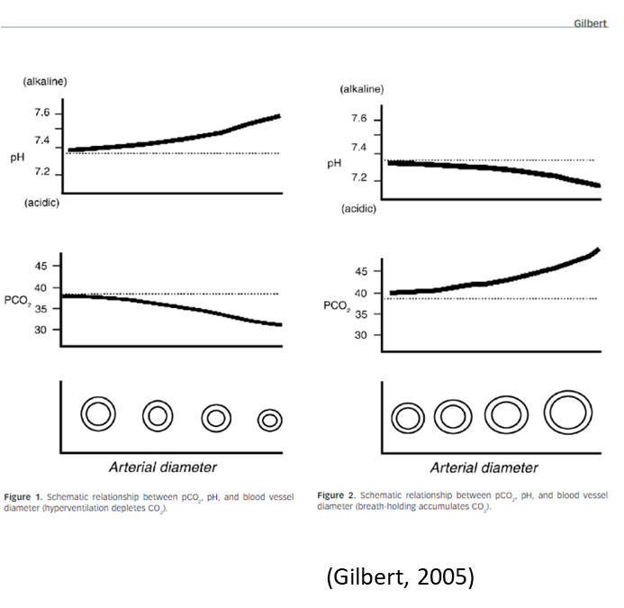
Biochemistry: Hyperventilation
Low CO2, hypocapnia
If chronic- new “set point” can lead to oversensitivity to exercise and relaxation; may cause anxiety, chest tightness, fatigue, and muscle pain.
Notes:
<number>

Slide 21
Biochemistry: Breathing Education
Five by Fives
Cup both hands over your nose and mouth
Breathe softly in and out through the nose five times
Drop your hands to your lap and mentally count up to five
Repeat breathing with cupped hands, counting each breath in and out up to five again
Repeat this 5 x 5 sequence until the symptoms subside
Notes:
<number>

Slide 22
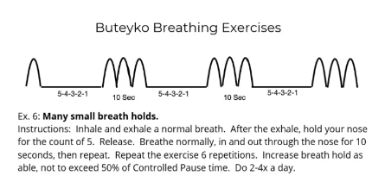
Biochemistry: Breathing Education
Many Small Breath Holds-
This is an exercise to help slow down your breathing when you feel you are breathing too fast or to get used to more CO2.
Take a normal breath in and out through your nose. Pinch your nose with your fingers and hold your breath for 3-5 seconds. Release your nose and breathe in normally through the nose for 10 seconds or about 3 normal breaths. Repeat for 3-5 mins. If you can practice this once and hour to start, then three times a day.
Notes:
<number>

Slide 23
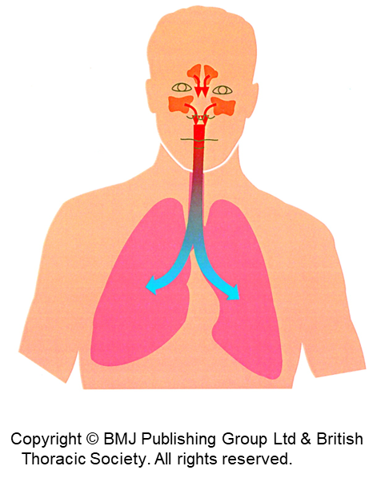
Biochemistry of Breathing: Nitric Oxide (NO)
Vasodilator – relaxes blood vessels in the lungs, improved blood flow (V/Q)
Nasal breathing carries NO down into the lungs to help redistribute the blood more evenly (decreased dead space).
Antiviral and antibacterial properties
Improves mucociliary function
Notes:
<number>

Slide 24
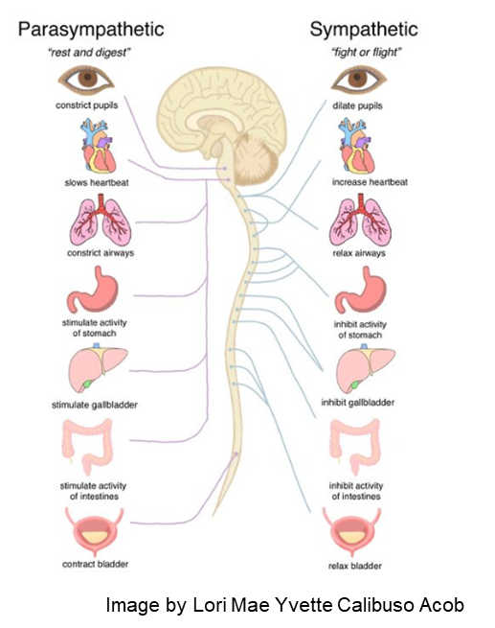
Psychophysiology of Breathing
Autonomic nervous system and regulation of emotions
Sympathetic and parasympathetic- Vagus nerve
Biochemical relationship to low CO2 (hyperventilation)
Biomechanical relationship to upper chest breathing vs diaphragmatic, fast vs slow, inhale vs exhale
Notes:
<number>

Slide 25
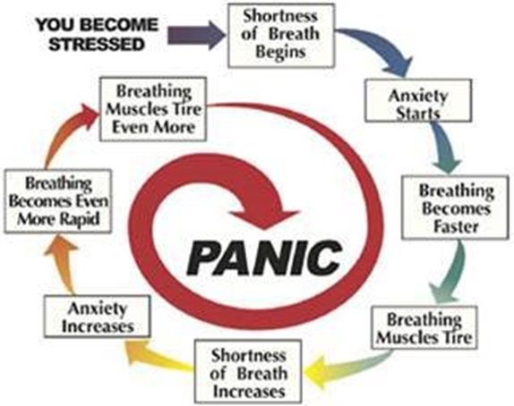
Psychophysiology: Breathing Pattern Presentations
Upper chest breathing vs abdomen
Rapid shallow breathing
Anxious or stressed demeanor
Breathing pattern with exercise
Clinical: HTN, increase RR, HR, RPE, BORG
Notes:
<number>

Slide 26
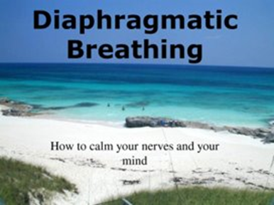
Psychophysiology of Breathing
Improvement in the biomarkers of respiratory rate and salivary cortisol levels
Improvement in systolic and diastolic blood pressure
Improvement in the stress subscale of the Depression Anxiety Stress Scales-21
Notes:
<number>

Slide 27
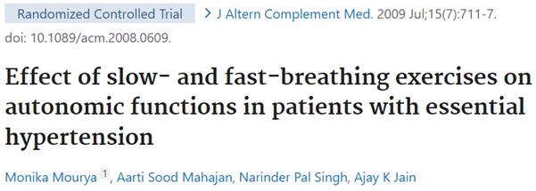
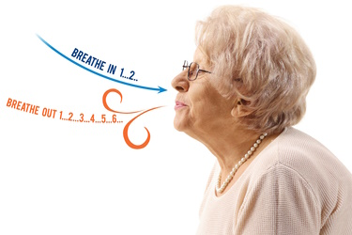
Psychophysiology: Breathing Education
Slow breathing had a stronger effect than fast breathing. BP decreased longitudinally over a 3-month period with both interventions.
Notes:
<number>

Slide 28
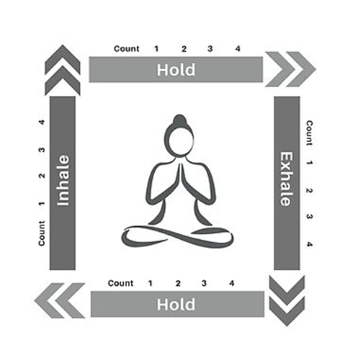
Psychophysiology: Breathing Education
Cadence or rhythmic breathing - breathing to a rhythm or a pattern
Examples:
In~1.2.3.4 Out~ 1.2.3.4.5.6 (6 breaths/min)
Square or box breathing
Notes:
<number>

Slide 29
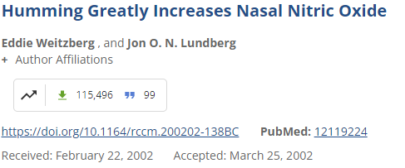
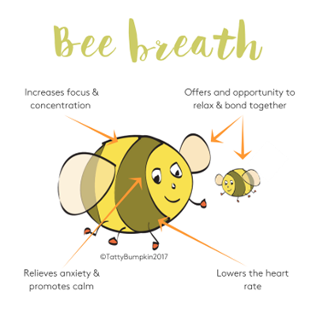
Psychophysiology: Breathing Education
Stimulating the Vagus Nerve
Humming or Bees breath (increases Nitric Oxide)
Promotes diaphragmatic breathing
Slow long exhales
Notes:
<number>

Slide 30
Presentation Take Away’s
Consider nasal assessment, history, and education
Help bring awareness to breathing – HiLo test, diaphragmatic, ribcage, upper chest, pauses between breaths (slower rhythm)
Activity- exercise, nasal breathing, and posture
“Nose, low, slow” Buteyko
“When in doubt, exhale out” BradCliff Breathing Method
Notes:
<number>

Slide 31
References
Breathing Methods that focus on BPD-The BradCliff Breathing Method (New Zealand Physios) and Buteyko Breathing Method (Patrick McKeown, Ireland)
Gilbert, Christopher. (2005). Better Chemistry Through Breathing: The Story of Carbon Dioxide and How It Can Go Wrong. 33.
Lundberg JON, Weitzberg ENasal nitric oxide in manThorax 1999;54:947-952.
Lindberg S, Cervin A, Runer T. Low levels of nasal nitric oxide (NO) correlate to impaired mucociliary function in the upper airways. Acta Otolaryngol. 1997 Sep;117(5):728-34. doi: 10.3109/00016489709113468. PMID: 9349871.
Kaminsky DA, Guntupalli KK, Lippmann J, Burns SM, Brock MA, Skelly J, DeSarno M, Pecott-Grimm H, Mohsin A, LaRock-McMahon C, Warren P, Whitney MC, Hanania NA. Effect of Yoga Breathing (Pranayama) on Exercise Tolerance in Patients with Chronic Obstructive Pulmonary Disease: A Randomized, Controlled Trial. J Altern Complement Med. 2017 Sep;23(9):696-704. doi: 10.1089/acm.2017.0102. Epub 2017 Jul 17. PMID: 28714735; PMCID: PMC5610410.
Kaushik RM, Kaushik R, Mahajan SK, Rajesh V. Effects of mental relaxation and slow breathing in essential hypertension. Complement Ther Med. 2006 Jun;14(2):120-6. doi: 10.1016/j.ctim.2005.11.007. Epub 2006 Jan 10. PMID: 16765850.
Edwards AM, Maguire GP, Graham D, Boland V, Richardson G. Four weeks of inspiratory muscle training improves self-paced walking performance in overweight and obese adults: a randomised controlled trial. J Obes. 2012;2012:918202. doi: 10.1155/2012/918202. Epub 2012 Jun 26. PMID: 22792448; PMCID: PMC3390056.
Shiraishi, Masashi & Higashimoto, Yuji & Sugiya, Ryuji & Mizusawa, Hiroki & Takeda, Yu & Noguchi, Masaya & Nishiyama, Osamu & Yamazaki, Ryo & Kudo, Shintarou & Kimura, Tamotsu & Matsumoto, Hisako. (2024). Enhanced diaphragm excursion and exercise tolerance in COPD patients through inspiratory muscle training after standardised pulmonary rehabilitation: randomised controlled trial. ERJ Open Research. 00035-2024. 10.1183/23120541.00035-2024.
Gilbert, Christopher. (2013). Interaction of psychological and emotional variables with breathing dysfunction. Recognizing and Treating Breathing Disorders: A Multidisciplinary Approach. 79-91. 10.1016/B978-0-7020-4980-4.00007-1.
McKeown, P. (2021). The Breathing Cure. Exercises to develop new breathing habits for a healthier, happier and longer life (1st edition). OxyAt Books.
Lundberg, J.O. (2008), Nitric Oxide and the Paranasal Sinuses. Anat Rec, 291: 1479-1484. https://doi.org/10.1002/ar.20782
Maniscalco M, Weitzberg E, Sundberg J, Sofia M, Lundberg JO. Assessment of nasal and sinus nitric oxide output using single-breath humming exhalations. Eur Respir J. 2003 Aug;22(2):323-9. doi: 10.1183/09031936.03.00017903. PMID: 12952268.
Weitzberg E, Lundberg JO. Humming greatly increases nasal nitric oxide. Am J Respir Crit Care Med. 2002 Jul 15;166(2):144-5. doi: 10.1164/rccm.200202-138BC. PMID: 12119224.
Hopper, Susan I.; Murray, Sherrie L.; Ferrara, Lucille R.; Singleton, Joanne K.. Effectiveness of diaphragmatic breathing for reducing physiological and psychological stress in adults: a quantitative systematic review. JBI Database of Systematic Reviews and Implementation Reports 17(9):p 1855-1876, September 2019. | DOI: 10.11124/JBISRIR-2017-003848
Ammous O, Feki W, Lotfi T, Khamis AM, Gosselink R, Rebai A, Kammoun S. Inspiratory muscle training, with or without concomitant pulmonary rehabilitation, for chronic obstructive pulmonary disease (COPD). Cochrane Database Syst Rev. 2023 Jan 6;1(1):CD013778. doi: 10.1002/14651858.CD013778.pub2. PMID: 36606682; PMCID: PMC9817429.

Slide 32
Questions? Julia O’Shea, RRT Julia.OShea@uvmhealth.org
“The Lung Lady”

